Slide 1

SeaAlert
Classifying Maritime Distress Messages with LLM- Generated Data
Presenter:
Tomer Atia, Ilana Estrin

Slide 2

Project Review-SeaAlert - Interim
Goal: Classify maritime VHF/SAR messages into 4 severity levels (Routine, Safety, Urgency, Distress)
Input & Output
What changed from the proposal
Novelty / contributions
input: message text (synthetic VHF-style transcript)
Output: 4-class severity label
Added shortcut-robust evaluation for codeword reliance
Evaluate on a hard subset: actual_codeword = NONE
Evaluate with masking: replace codewords with [CODEWORD]
Built a balanced synthetic dataset (300 samples, 75 per class) with realistic metadata (style, scenario, etc.)
Showed that codewords and style can act as shortcuts and measured the drop under masking
Compared a classical baseline (TF-IDF+LR) vs a transformer baseline (DistilBERT) under the same robust settings

Slide 3

Related Work (Previous Work)
Title | Year | Task | Data & modality | Method | Key results | Relation to SeaAlert
Deep ensemble multitask classification of emergency medical call incidents combining multimodal data improves emergency medical dispatch. [reference] | 2021 | Real-time triage of emergency medical call incidents (life-threatening, response delay, jurisdiction) | 1,244,624 incidents (Valencian EMS dispatch, Spain, 2009-2012), includes free-text dispatcher observations | Deep ensemble multitask model integrating context, clinical, and text subnetworks (DeepEMCA2) | Strong triage signal exists in free text beyond protocol keywords | Supports severity inference from context, not only explicit codewords
AI-based approach for transcribing and classifying unstructured emergency call data: A methodological proposal. [reference] | 2023 | Pipeline: audio transcription + feature extraction + classification of unstructured emergency calls | All “1-9-2” calls received in 2019 by a SAMU call center in southern Brazil | End-to-end workflow: ASR (audio-to-text) + NLP classification for decision support | Demonstrates feasibility of noisy speech-to-text then text classification | Closest pipeline analog: noisy comms -> transcript -> severity class (same story as SeaAlert)
Adaptation and Optimization of ASR for the Maritime Domain in VHF Communication. [reference] | 2025 | Maritime VHF domain ASR (speech -> text) under noise, accents, and domain terminology | Custom maritime database: ~62 hours of VHF conversations (EN+DE) with transcripts; test split includes ~6 hours of real VHF calls | Fine-tunes XLSR; compares to Whisper; evaluates WER | Reports WER improvements via domain adaptation vs generic ASR | Domain anchor: realistic VHF transcripts matter; better ASR can improve downstream severity classification
Synthetic Data Generation with Large Language Models for Text Classification: Potential and Limitations. [reference] | 2023 | When LLM-generated synthetic labeled data helps (or hurts) text classification | Synthetic-data training across text-classification settings; analyzes moderators of success | LLM-based data generation, trains classifiers, analyzes what drives performance | Synthetic data can work, but performance depends on subjectivity/ambiguity and evaluation setup | Warning: handle borderline cases and evaluate robustly (NONE-only + masking to avoid shortcut artifacts)

Slide 4

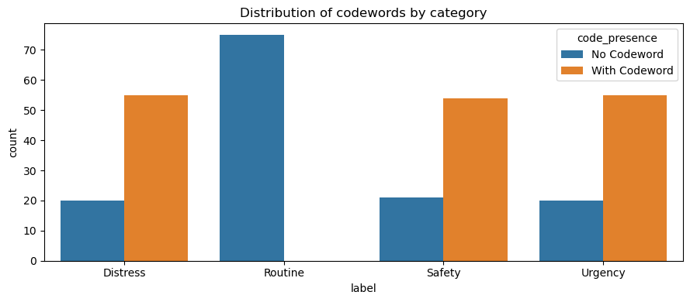
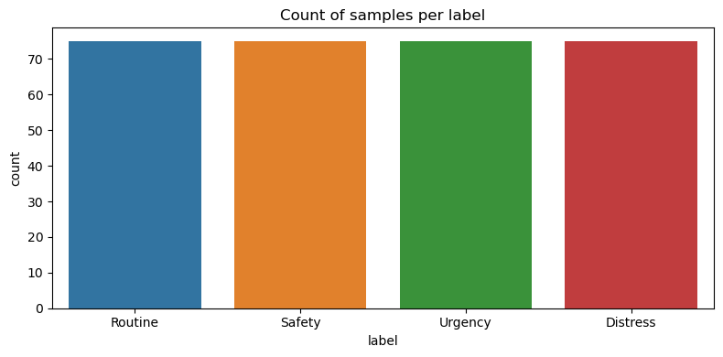
Dataset + EDA (300 samples)
Dataset (what we created)
Data generation + labeling
Synthetic VHF/SAR message dataset: 300 samples
4 severity labels: Routine, Safety, Urgency, Distress
Balanced: 75 per class
Fields: text, label, scenario_type, style, vessel, location, weather, POB, codeword
Messages were LLM-generated with controlled scenario + metadata (style, vessel, location, weather, POB)
Labels assigned by scenario severity (4-class target)
Codewords may appear (MAYDAY / PAN PAN / SECURITE) to reflect real radio protocol
Added codeword extraction + masking to support robustness tests in Stage 2
EDA highlights
Clean core fields: 0 missing in text+label, no duplicates
Balanced classes: 75 per class
Shortcut signals: codewords present in ~55% + style-label correlation
Takeaway: evaluate on NONE-only + masked input to test true context understanding

Slide 5

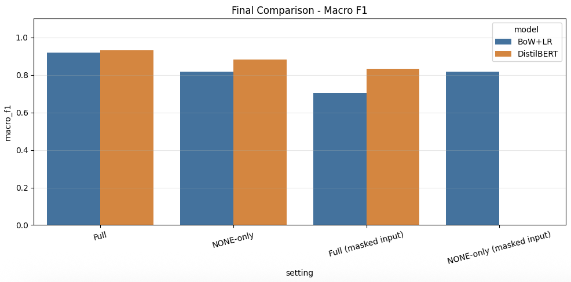
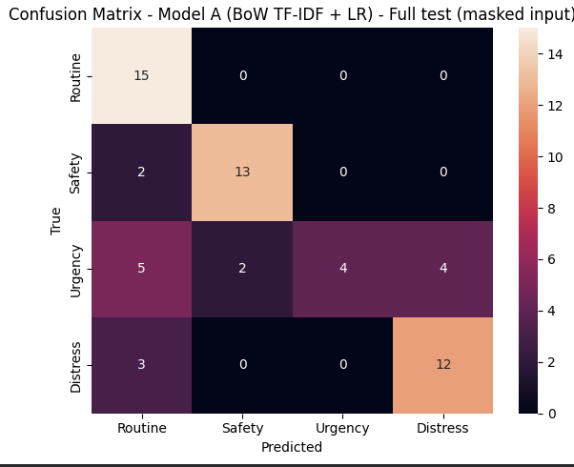
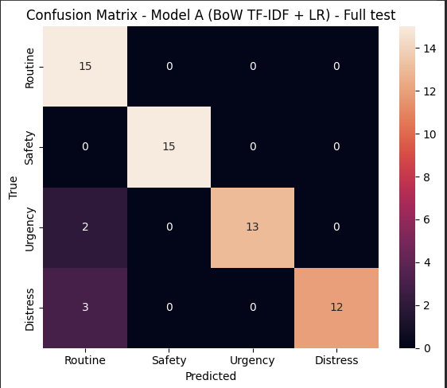
Baseline Solution and Results
Baselines
Results
Evaluation setup
Model A (classical): TF-IDF (1-2 grams) + Logistic Regression
Model B (pretrained): DistilBERT fine-tuning (distilbert-base-uncased), 4-class head
Key finding: Masking causes a large drop (especially BoW+LR) → indicates shortcut reliance on codewords.
DistilBERT is more robust under masking and performs best on NONE-only.
Full test: standard split (60 samples)
NONE-only: test samples with actual_codeword = NONE (31 samples)
Masked input: replace MAYDAY / PAN PAN / SECURITE with [CODEWORD]
BoW+LR Confusion Matrices (Full vs Masked):

Slide 6

Plan (Roadmap to Final Project)
Step | Scope (what) | Technical (how) | Due date | Expected outcome
1 | Expand dataset to 1,000-1,500 samples | Generate new scenarios/styles, keep balanced classes, keep metadata (style, vessel, weather, location, POB) | Week 1 | Larger, more diverse dataset, fewer artifacts
2 | Improve dataset quality | Add hard cases (implicit distress), add borderline examples, reduce “template” patterns | Week 1 | Better realism, harder evaluation
3 | Stronger baselines | Fine-tune RoBERTa-base and/or DeBERTa-v3-base for 4-class classification | Week 2 | Higher Macro-F1, better generalization
4 | Robustness evaluation | Re-run Full / NONE-only / Masked + add cross-style split (train on styles A, test on style B) | Week 2 | Proof model learns context, not shortcuts
5 | Error analysis | Inspect confusion pairs + analyze failures (esp. Urgency vs Distress), sample-level review | Week 2 | Clear explanation of weaknesses + next fixes
6 | Optional: LLM baseline | Add LLM zero-shot (prompted classification) as reference baseline | Week 3 | Compare classical vs transformer vs LLM
7 | Package + final deliverables | Clean notebook, tables/graphs, conclusions, limitations | Week 3 | Ready report + reproducible results
8 | Prepare final presentation | Final slides, final figures, key takeaways + demo examples | Final week | Final presentation ready

